Slide 1

INDIA’S COVID-19 TRACKER
Presented by:
Swathi B Nair
Batch Code:
2022-7265
Enrollment no:
EBEON0422589627

Slide 2

CONTENT
Introduction ----------------------------------------------
Tools used to create dashboard -----------------------
Overview of Dataset ------------------------------------
Power BI --------------------------------------------------
Power BI Dashboard
Cover page ----------------------------------------
COVID-19 Overview ----------------------------
India Report ---------------------------------------
India Overview ------------------------------------
SAS Tool ---------------------------------------------------
Python Programming ------------------------------------
Tableau ----------------------------------------------------
3
4
5
6
7
9
15
18
20
28
38

Slide 3



INTRODUCTION
COVID-19 is the infectious disease caused by the most recently discovered corona virus. This new virus and disease were unknown before the outbreak began in Wuhan, China, in December 2019. The most common symptoms of COVID-19 are fever, tiredness, and dry cough.
The first cases of COVID-19 in India were reported on 30 January 2020 in three towns of Kerala, among three Indian medical students who had returned from Wuhan, the epicenter of the pandemic. Lockdowns were announced in Kerala on 23 March, and in the rest of the country on 25 March.

Slide 4
TOOLS USED TO CREATE DASHBOARD
POWER BI
SAS TOOL
PYTHON
TABLEAU

Slide 5
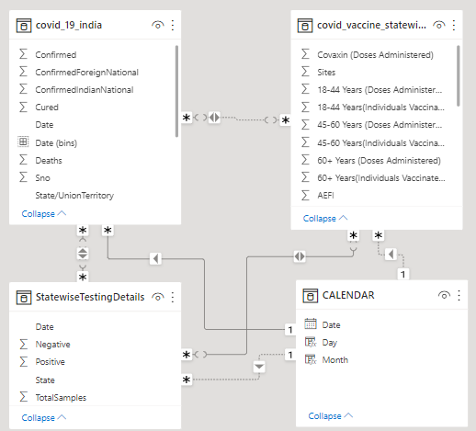
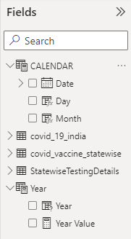
OVERVIEW OF THE DATASET
The excel dataset used in this project consists of India’s COVID-19 details. It has 3 tables associated with it: covid_19_india, covid_vaccine_statewise and StateWiseTestingDetails. The first table consists of 18110 observations and column headers are state, date, confirmed cases, cured cases and death count. The second table has 7845 observations and column headers are state, date, first dose, second dose, total doses, different age groups, gender-wise vaccination count and total individuals vaccinated. The third table consists of 16336 observations and column headers are total samples collected, state, positive and negative cases. Apart from this I have create a new table named “CALENDAR” using DAX query and created 3 columns for that table. Another “what if parameter” named “Year” is also created.

Slide 6
POWER BI
Microsoft Power BI is a collection of apps, software services and connectors that come together to turn unrelated data into visually impressive and interactive insights. Power BI can work with simple data sources like Microsoft Excel and complicated ones like cloud-based or on-premises hybrid Data warehouses. Power BI has the capabilities to easily connect to your data sources, visualize and share and publish your findings with anyone and everyone.
It converts data from different sources to build interactive dashboards and Business Intelligence reports. In Power BI, you can create visualization in two ways. First is by adding from the right-side pane to Report Canvas. By default, it is the table type visualization, which is selected in Power BI. Another way is to drag the fields from right side bar to the axis and value axis under Visualization.

Slide 7
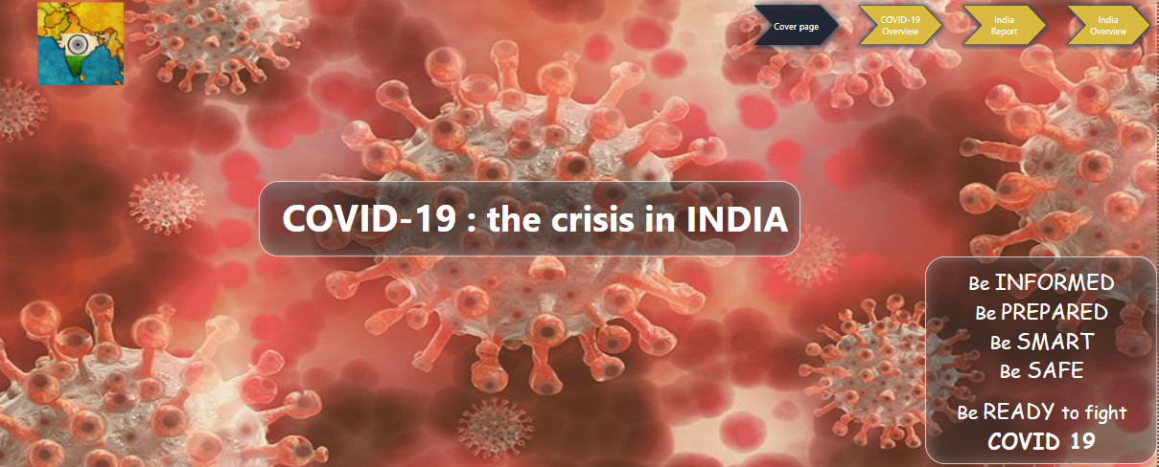
COVER PAGE

Slide 8
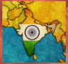

Map image when clicked will take you to India’s official website containing COVID’s live data.
This is a Bookmark Navigator which when clicked will help to reach the corresponding dashboard. The black icon denotes the current dashboard and the yellow icons are for the rest of the pages.

Slide 9
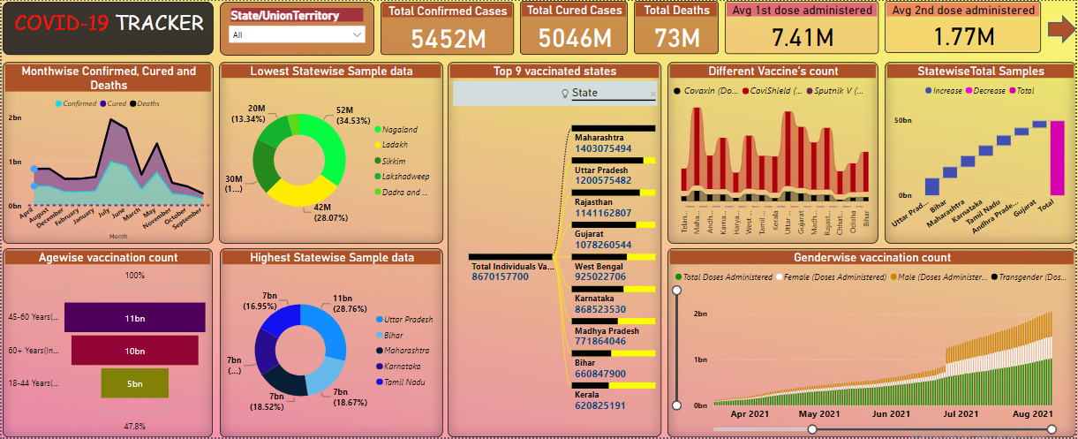
COVID-19 OVERVIEW

Slide 10
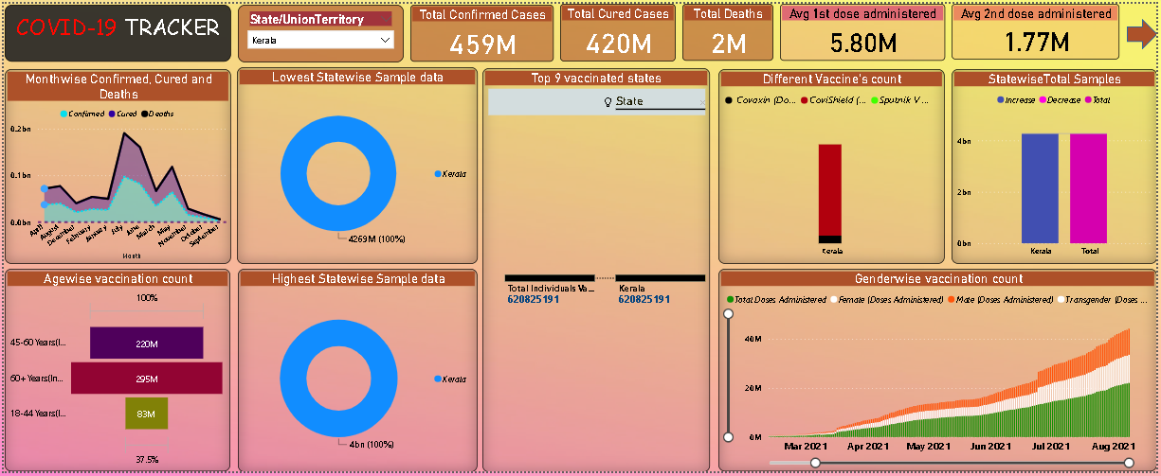

Slide 11
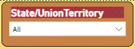
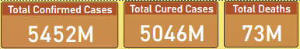
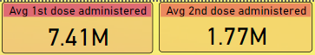
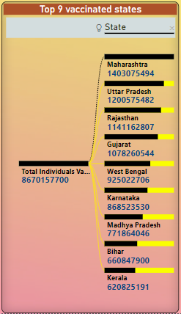
First image shows a filter whose value is State. The dropdown shows different states.
Second image shows 3 cards: Total confirmed, cured and deaths.
Third image shows the average first and second doses count.
This is a tree map which shows the top 9 vaccinated countries with Maharashtra being the most vaccinated state.

Slide 12
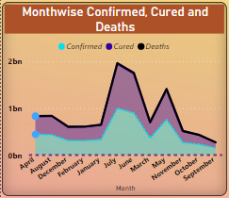
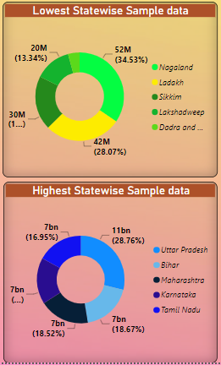
This is an area chart which shows the total confirmed, cured and deaths total during different months.
These are two pie charts. The top one shows the lowest 5 states whose samples are collected. And the bottom one shows the highest 5 states whose samples are collected

Slide 13
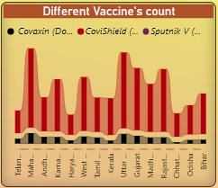
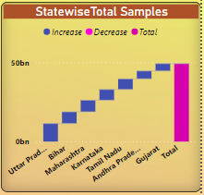
This is a rainbow chart which shows different vaccination’s total in different states.
This is a waterfall chart which shows the total samples collected from each state. Increase in count is shown by blue colour and total by purple colour.

Slide 14
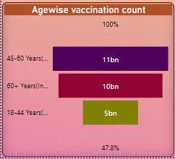
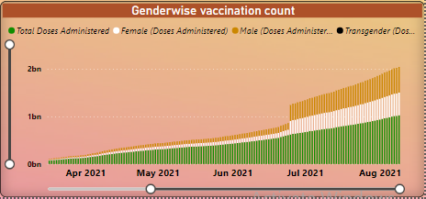
This is a funnel chart which shows the total vaccination count of different age categories. From the graph it is clear that people of age between 45 and 60 took the most vaccination and 18 to 44 took the least.
This is a stacked column chart which shows the total vaccination count of different genders during each month.

Slide 15
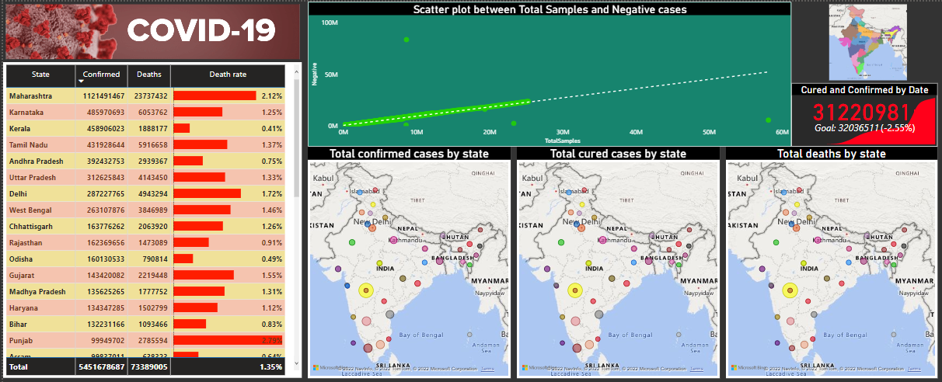
INDIA REPORT

Slide 16
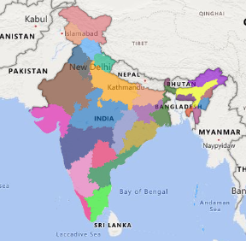
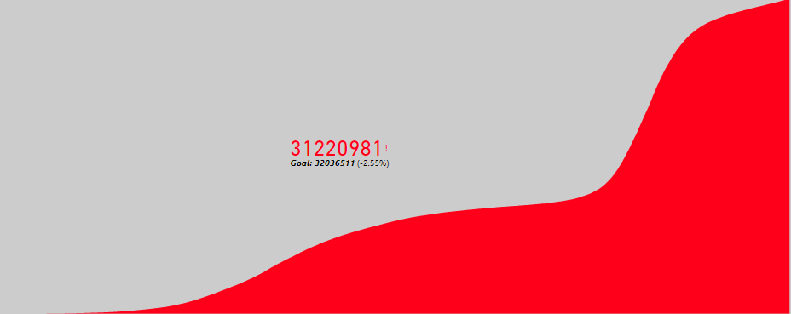
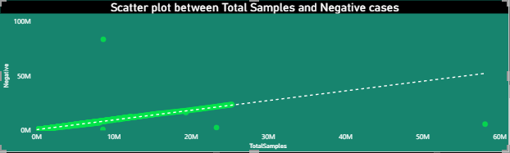
Map image when clicked will navigate to India’s overview dashboard.
This is a KPI indicator which shows the Confirmed vs Cured cases.
The scatter plot compares the total samples tested and those which turned negative.

Slide 17
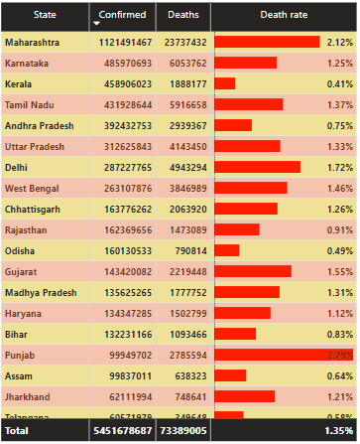
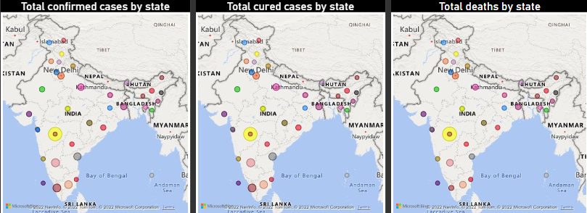
Table shows different states and their confirmed cases and death count. It also shows the Death count which is calculated using quick measure and the bars are shown using conditional formatting.
The three maps shows their respective total confirmed, cured and death count.

Slide 18
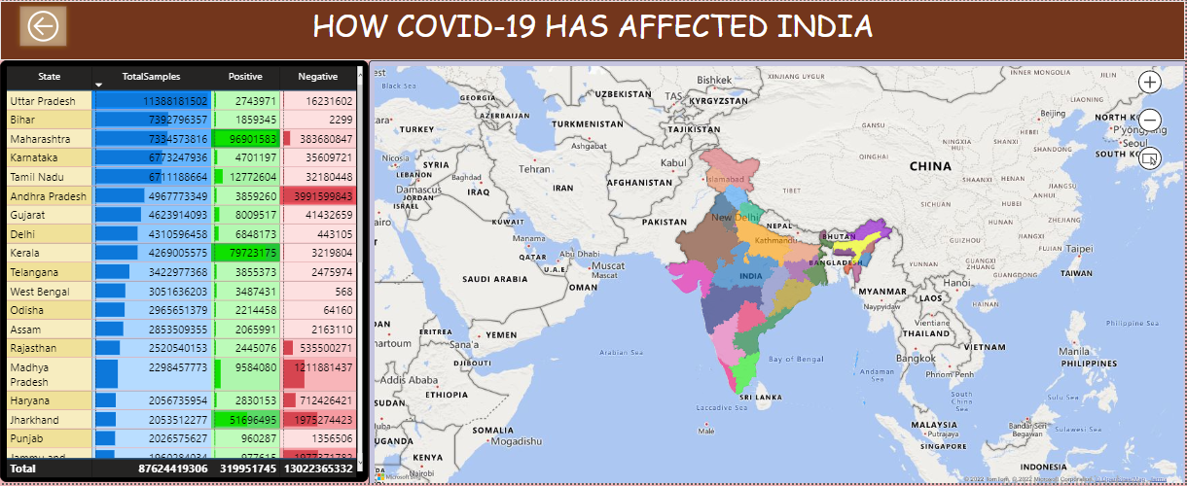
INDIA OVERVIEW

Slide 19
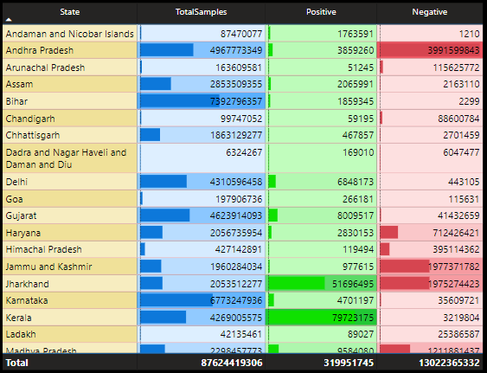
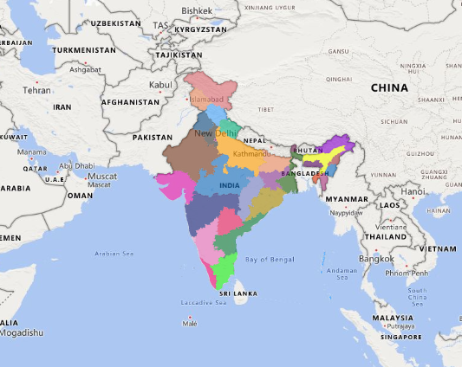
Table shows different states and their total samples collected, positive and negative cases. It also shows the bars which are shown using conditional formatting.
The India’s map shows the entire view. It’s tooltip will show the total confirmed, cured, deaths, total doses administered and vaccinated count.

Slide 20
Statistical Analysis System (SAS)
SAS stands for Statistical Analysis System. It was created in the year 1960 by the SAS Institute. It is an integrated software suite for advanced analytics, business intelligence, data management, and predictive analytics. SAS is a group of computer programs that work together to store data values and retrieve them, modify data, compute simple and complex statistical analyses, and create reports.
Using SAS, we can visualize data in various forms such as Boxplots, Bar Charts, Pie Charts, Scatterplots and Histograms. SAS technology helps you prepare data, create reports and graphs, discover new insights and share those visualizations with others via the Web, PDFs or mobile devices. Data visualization technology from SAS delivers fast answers to complex questions, regardless of the size of your data.

Slide 21
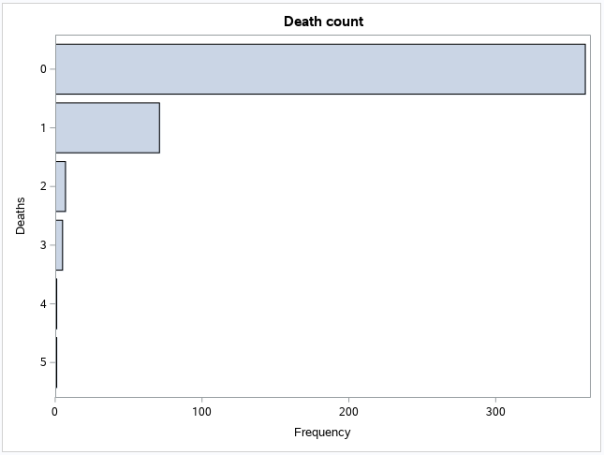
BAR CHART
CODE
**BAR CHARTS;
STYLE = EGDefault;
proc SGPLOT data = IMPORT;
hbar Deaths;
title 'Death count' ;
run;
quit;
This is a horizontal bar graph which shows the death count and its respective frequency.

Slide 22
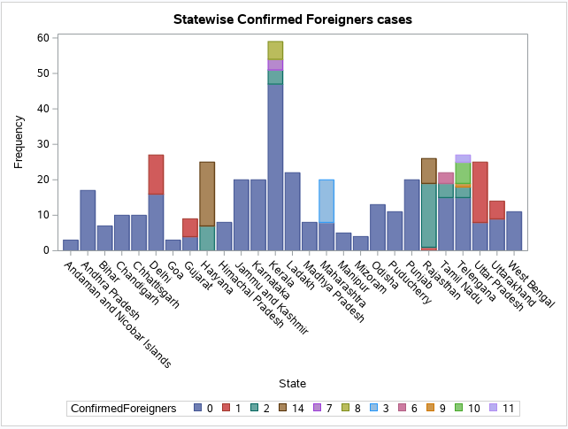
STACKED BAR CHART
CODE
**STACKED BAR CHARTS;
proc SGPLOT data = IMPORT;
vbar State/ group=ConfirmedForeigners ;
title 'Statewise Confirmed Foreigners cases';
run;
quit;
This is a vertical stacked bar chart which shows the variation of different states and their confirmed foreigner case.

Slide 23
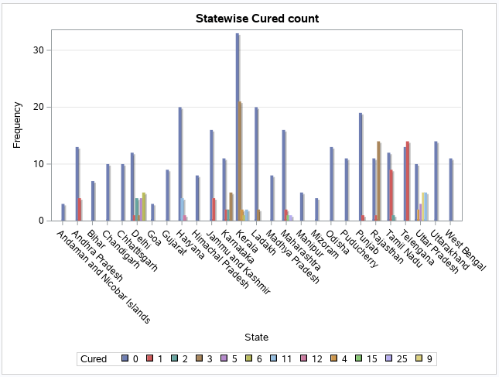
CLUSTERED BAR CHART
CODE
**CLUSTERED BAR CHARTS;
proc SGPLOT data = IMPORT;
vbar State /group = Cured GROUPDISPLAY = CLUSTER
datalabel datalabelattrs= State group=Cured dataskin=crisp; yaxis grid;
title 'Statewise Cured count';
run;
quit;
This is a vertical clustered bar graph which shows the variation of different states and their cured cases.

Slide 24
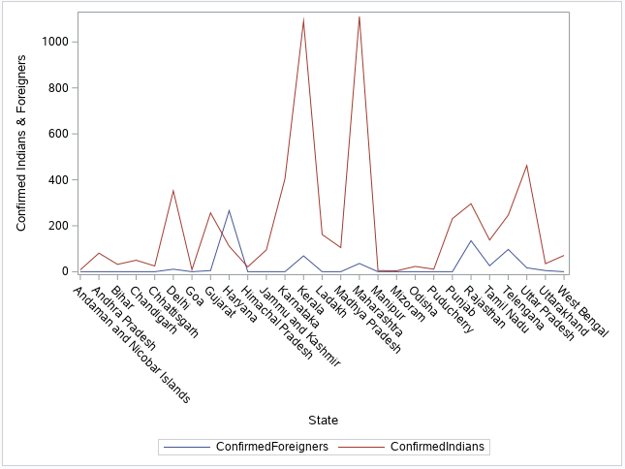
LINE CHART
CODE
**LINE CHART;
proc sgplot data = IMPORT;
vline State/response = ConfirmedForeigners;
vline State/response = ConfirmedIndians;
yaxis label = "Confirmed Indians & Foreigners";
run;
This are two-line graphs which shows the variation of different states and their confirmed Indian and Foreigner cases.

Slide 25
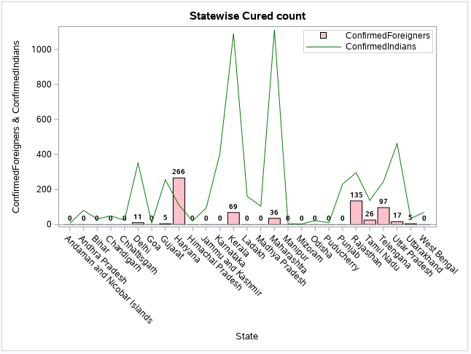
BAR-LINE CHART
CODE
**Bar-Line Chart;
proc sgplot data=IMPORT;
vbar State/ response=ConfirmedForeigners datalabel datalabelattrs = (weight = bold)
fillattrs= (color = pink);
vline State/ response=ConfirmedIndians
lineattrs =(thickness = 1 color=green) ;
xaxis label= "State";
yaxis label = "ConfirmedForeigners & ConfirmedIndians";
keylegend / location=inside position=topright across=1;
run;
This is a bar and line graph which shows the variation of different states and their confirmed Indian and Foreigner cases.

Slide 26
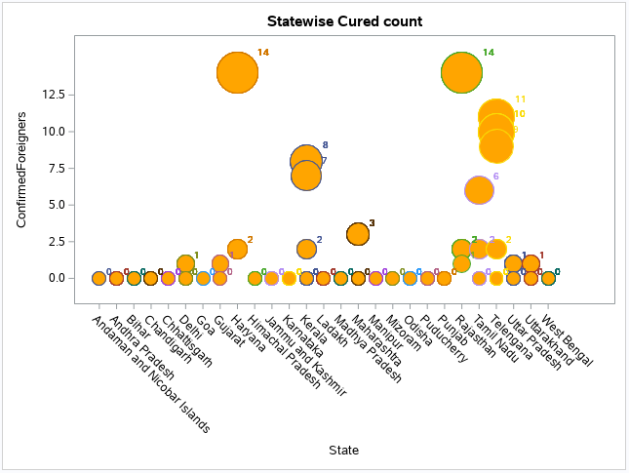
BUBBLE CHART
CODE
**Bubble Chart;
proc sgplot data = IMPORT;
bubble X=State Y=ConfirmedForeigners size= ConfirmedForeigners
/fillattrs=(color = orange) datalabel = ConfirmedForeigners group=State;
run;
This is a bubble graph which shows the variation of different states and their confirmed Foreigner cases.

Slide 27
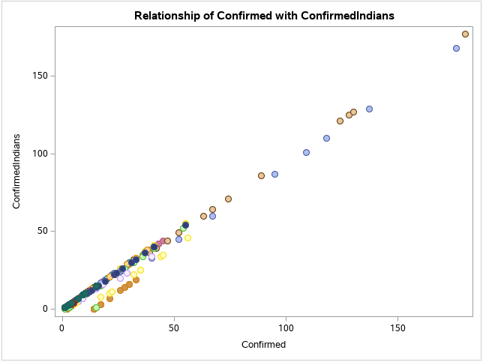
SCATTER PLOT
CODE
**Scatter Plot;
proc sgplot data = IMPORT;
title 'Relationship of Confirmed with ConfirmedIndians';
scatter X= Confirmed Y = ConfirmedIndians/group=State
markerattrs=(symbol=circlefilled size=10) filledoutlinedmarkers;
run;
This is a scattered plot which shows the variation of total confirmed cases versus confirmed Indian cases.

Slide 28
PYTHON Programming
Python is a popular programming language. It was created by Guido van Rossum and released in 1991. It is used for web development (server-side),software development, mathematics and system scripting.
Python works on different platforms (Windows, Mac, Linux, Raspberry Pi, etc.).It has a simple syntax like the English language which allows developers to write programs with fewer lines than some other programming languages. It runs on an interpreter system, meaning that code can be executed as soon as it is written. This means that prototyping can be very quick. It can be treated in a procedural way, an object-oriented way or a functional way.
Python provides various libraries that come with different features for visualizing data. All these libraries come with different features and can support various types of graphs. The four such libraries are:
Matplotlib
Seaborn
Bokeh
Plotly

Slide 29
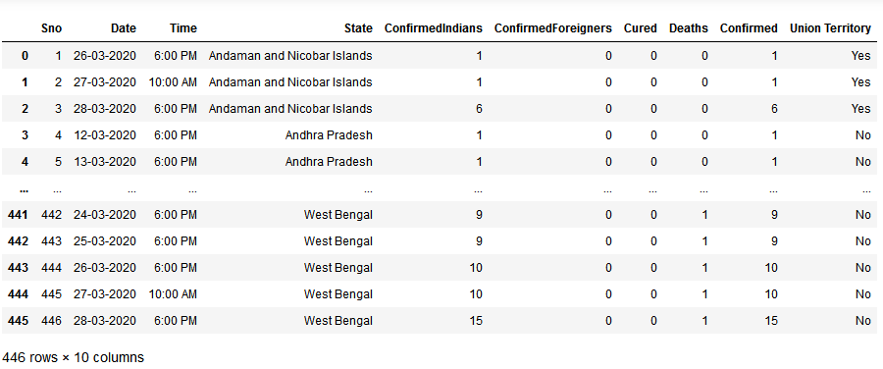
import pandas as pd
import numpy as np
import seaborn as sns
import matplotlib.pyplot as plt
data = pd.read_csv(r"C:\Users\user\Desktop\COVID-19 Statewise Data.csv")
data

Slide 30
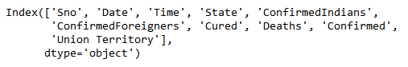
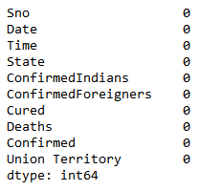
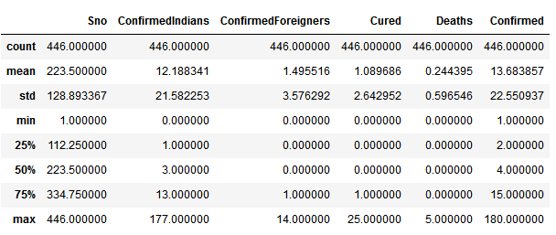
data.columns
data.isnull().sum()
data.describe()

Slide 31
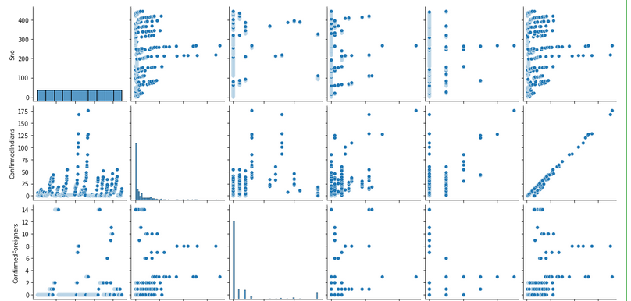
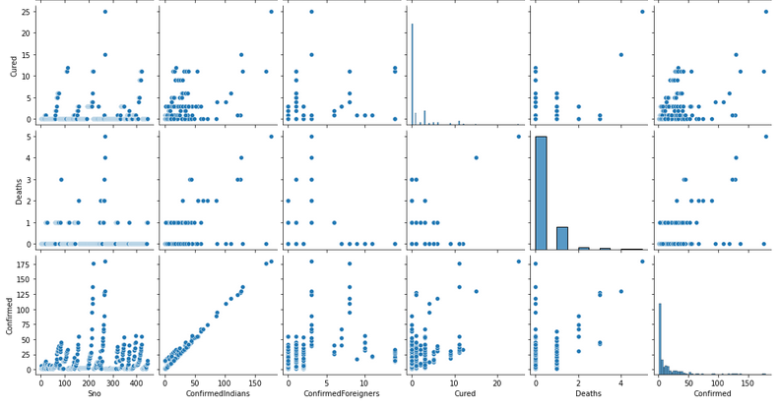
sns.pairplot(data)

Slide 32
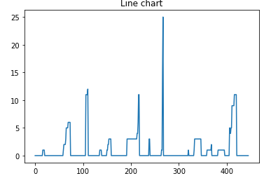
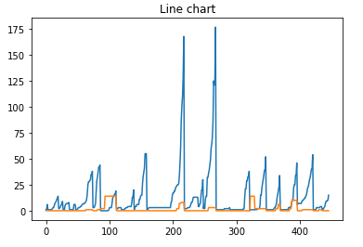
#Line chart
plt.plot(data['Cured'])
plt.title("Line chart")
plt.show
#line chart between Confirmed Indians and Foreigners
plt.plot(data['ConfirmedIndians'])
plt.plot(data['ConfirmedForeigners'])
plt.title("Line chart")
plt.show

Slide 33
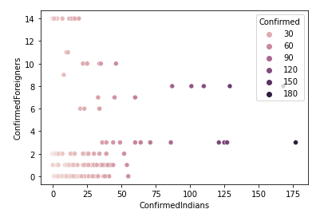
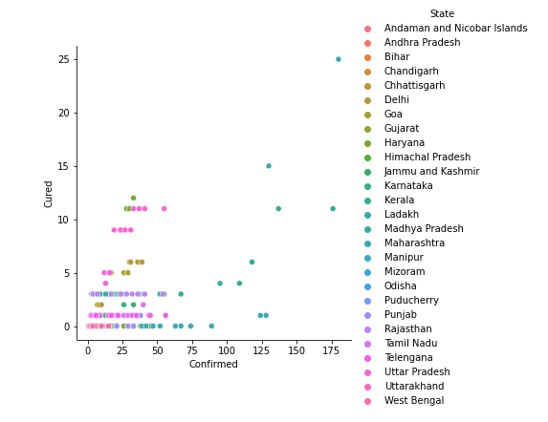
# Relating variables using Scatter plot
sns.scatterplot(x=data.ConfirmedIndians,y=data.ConfirmedForeigners, hue=data.Confirmed)
sns.relplot(x="Confirmed", y="Cured", hue=data.State, data=data)

Slide 34
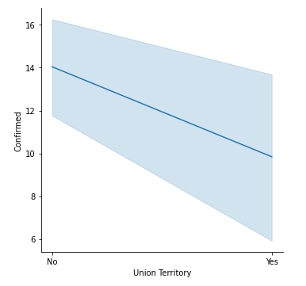
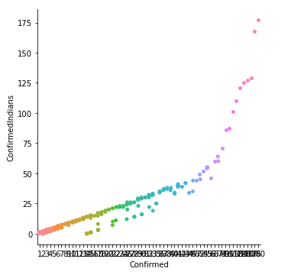
sns.relplot(y="Confirmed", x="Union Territory", kind='line', data=data)
sns.catplot(x="Confirmed", y="ConfirmedIndians", data=data)

Slide 35
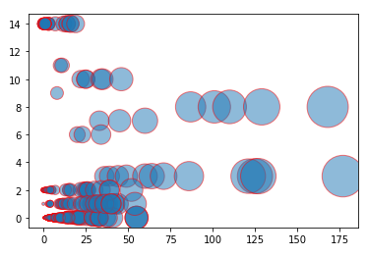
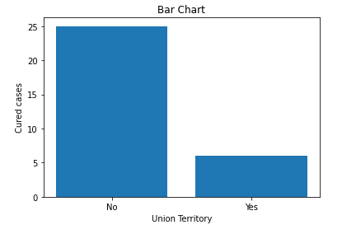
#bubble chart
x=data['ConfirmedIndians']
y=data['ConfirmedForeigners']
z=data['Confirmed']
plt.scatter(x,y,s=z*10,alpha=0.5,edgecolors='red')
plt.bar(data['Union Territory'], data['Cured'])
plt.title("Bar Chart")
plt.xlabel('Union Territory')
plt.ylabel('Cured cases')
plt.show()

Slide 36
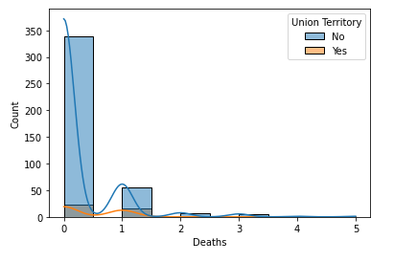
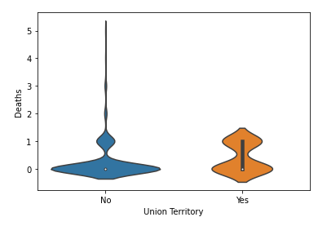
#Histogram
sns.histplot(x='Deaths', data=data, kde=True, hue='Union Territory')
plt.show()
#Violin chart
sns.violinplot(x="Union Territory", y="Deaths",data=data)

Slide 37
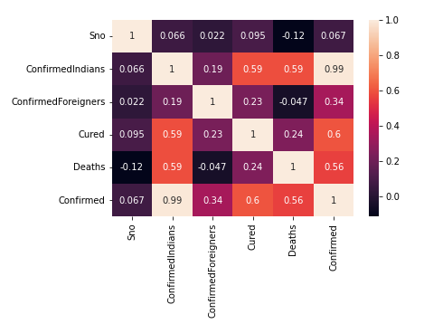
#Heat map
sns.heatmap(data.corr(),annot=True)

Slide 38
TABLEAU
Tableau is a powerful tool used for data analysis, visualization. It allows creating amazing and interactive visualization and that too without coding. Tableau is very famous as it can take in data and produce the required data visualization output in a very short time.
Tableau is the fastly growing and powerful data visualization tool. It is a business intelligence tool which helps us to analyze the raw data in the form of the visual manner; it may be a graph, report, etc.
Data analysis is very fast with Tableau, and the visualizations created are in the form of worksheets and dashboards. Any professional can understand the data created using Tableau. Tableau software doesn't require any technical or any programming skills to operate. Tableau is easy and fast for creating visual dashboards.

Slide 39
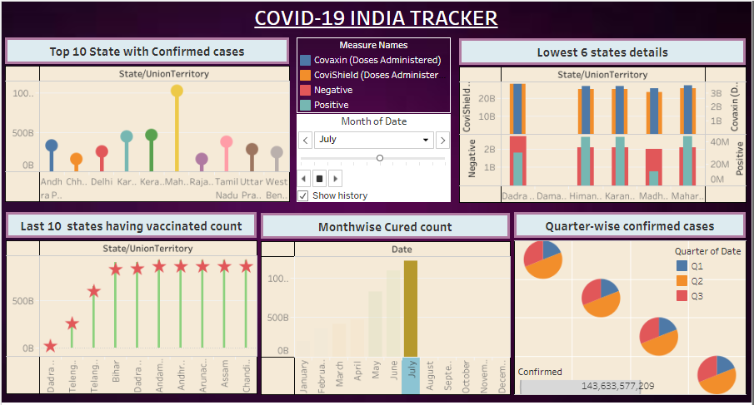

Slide 40


This is a lollipop chart which shows the States having top 10 COVID-19 confirmed cases.
This is a bar inside bar dual axis chart. The top one shows the total covishield and covaxin count of lowest 6 states. The bottom graph shows the total negative and positive cases in lowest 6 states.

Slide 41



This is a different shape chart which shows ten states having lowest vaccinations count.
This is a multiple pie chart which shows total confirmed cases in different quarters.

Slide 42


This is an animated chart which shows the total cured count in different months. It changes automatically when the start button is clicked. The current month will have a solid color and the previous months will have a faded color.

Slide 43
THANK YOU!! STAY HOME, STAY SAFE!

